Slide 1
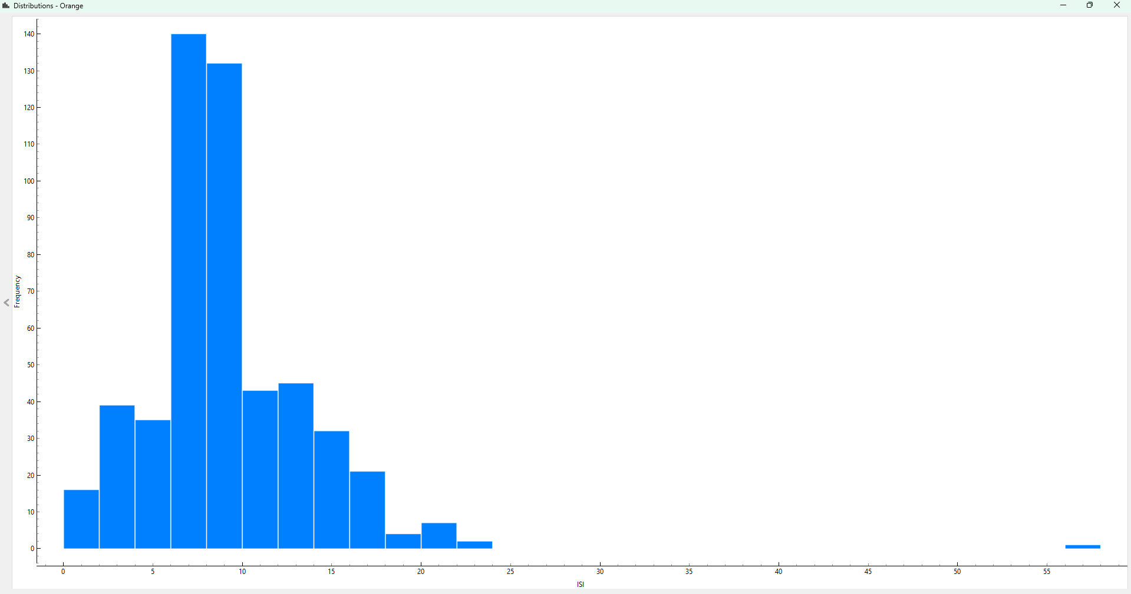
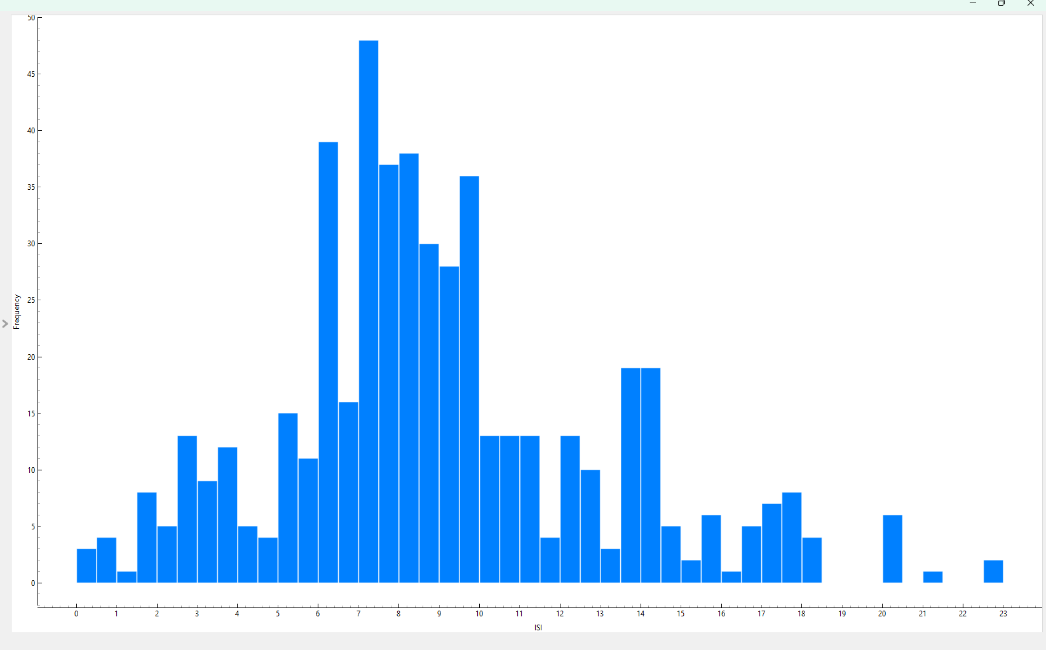
Look at the assignment sheet, you will see there are 8 requirements listed. This template uses the same 8 numbers to show how you might present your work.
You might choose a different layout – that is fine. You may find you need more space in one section and less in another. This is just an example, you should choose your own layout, to suit your results. Obviously, you should remove these instructions!
CSCU9M5 Assignment 1. Student Number 3344671
2. Project Methodology List the steps you took to carry out the project Include train/validate/test split and model selection This list should cover ALL the steps in the process … … 4. Data Preparation Show two histograms here. One should show the distribution of one variable before it has been cleaned. The other should show the distribution of the same variable after cleaning. Choose a variable that needs to be cleaned!! | 3 Variables/ Data Understanding Say which variables you used in your model, and whether you treated then as numeric or categorical. Explain the impact your choices will have on the models you build. You can use a table:
5. Model Training and Hyper Parameters A table showing the different models and hyper parameters you trained, along with the correct metric for each; Add a sentence on how you chose the hyper parameter values. Make sure you name the metric correctly. | Model Hyper Parameters
6. Final Model and Results Say how you chose the final model to test, and how you trained that model. Put the confusion matrix here Explain what the confusion matrix tells us. | 7. Insight about data or models gained For example, did you learn anything about specific features that drive the model? Is the model biased towards particular groups in the data? Is the model you've chosen good for helping us to understand why particular predictions are made?
Variable | Type
Variable 1 | Numeric
Variable 2 | Categorical
Model | Hyper Parameters | Validation Metric
Model 1 | Hyper parameter list | A%
Model 2 | Hyper parameter list | B%
Model 3 | Hyper parameter list | C%
Model 4 …. | Hyper parameter list | D%
Explain here how you chose the hyper parameter settings to explore and how you ran your experiments.
Actual / Predicted | Good | Bad
Good | 220 | 25
Bad | 32 | 195
8. References
[1] If you reference any papers or websites, list them here

Slide 2
Look at the assignment sheet, you will see there are 8 requirements listed. This template uses the same 8 numbers to show how you might present your work.
You might choose a different layout – that is fine. You may find you need more space in one section and less in another. This is just an example, you should choose your own layout, to suit your results. Obviously, you should remove these instructions!
CSCU9M5 Assignment 1. Student Number xxxxxx
2. Project Methodology
List the steps you took to carry out the project
Include train/validate/test split and model selection
This list should cover ALL the steps in the process
…
…
3 Variables/ Data Understanding
Say which variables you used in your model, and whether you treated then as numeric3 Variables
Say which variables you used in your model, and whether you treated then as numeric or categorical. Explain the impact your choices will have on the models you build. You can use a table:
or categorical. Explain the impact your choices will have on the models you build. You can use a table:
Variable | Type
Variable 1 | Numeric
Variable 2 | Categorical
4. Data Preparation
Show two histograms here. One should show the distribution of one
variable before it has been cleaned. The other should show the
distribution of the same variable after cleaning. Choose a variable
that needs to be cleaned!!
Before Cleaning
After Cleaning
5. Model Training and Hyper Parameters
A table showing the different models and hyper parameters you trained, along with the correct metric for each; Add a sentence on how you chose the hyper parameter values. Make sure you name the metric correctly.
Model | Hyper Parameters | Validation Metric
Model 1 | Hyper parameter list | A%
Model 2 | Hyper parameter list | B%
Model 3 | Hyper parameter list | C%
Model 4 …. | Hyper parameter list | D%
Explain here how you chose the hyper parameter settings to explore and how you ran your experiments.
6. Final Model and Results
Say how you chose the final model to test, and how you trained that model.
Put the confusion matrix here
Actual / Predicted | Good | Bad
Good | X | X
Bad | X | X
Explain what the confusion matrix tells us.
7. Insight about data or models gained
For example, did you learn anything about specific features that drive the model? Is the model biased towards particular groups in the data? Is the model you've chosen good for helping us to understand why particular predictions are made?
8. References
[1] If you reference any papers or websites, list them here

